Slide 1
Dark Fleet Analysis
Presented by Matthew McCarroll
August 2025

Slide 2
Dark Fleet Data
TankerTrackers provides free data detailing sanctioned dark fleet vessels
Api allows instant updates, although website gives class size while the api does not
https://tankertrackers.com/report/sanctioned

Slide 3
Dark Fleet Data Cont.
Vessel imo was used to webscrape for build year and DWT
Build year cross checked from datasheet provided by oilBandit@x.com
At time of analysis, collected dead weight ton (DWT), build year, and class size for 1204 sanctioned vessels

Slide 4
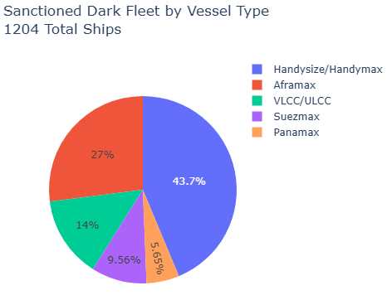
Dark Fleet Overview
Approximately half of sanctioned vessels are oil tankers

Slide 5
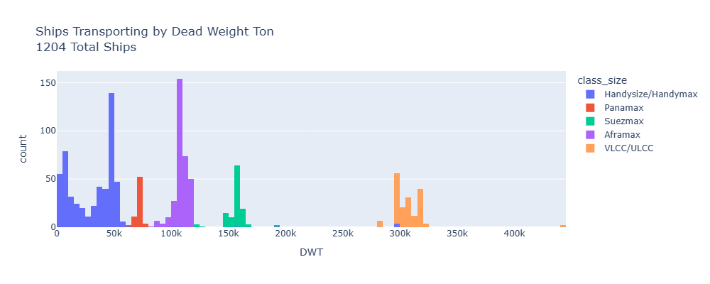
Dark Fleet Overview
Vessel class size identified by DWT

Slide 6
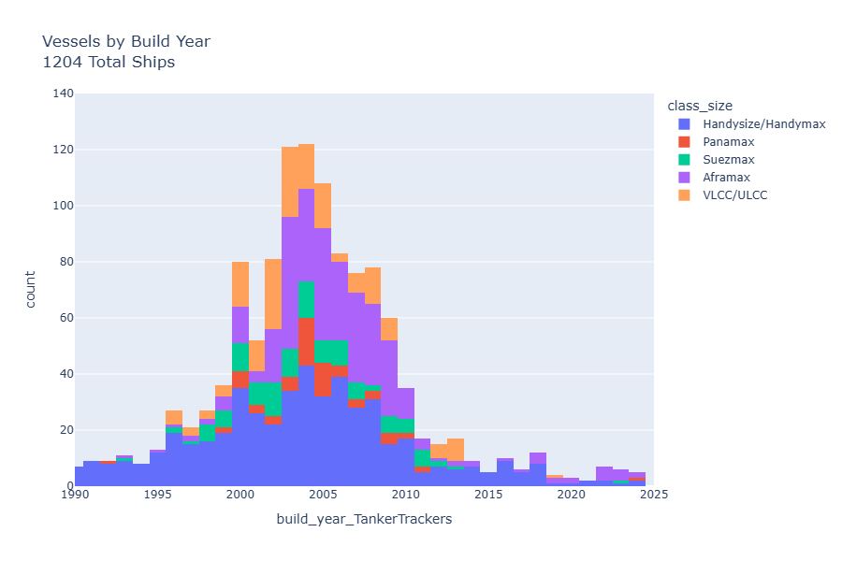
Dark Fleet Overview
Normal distribution of build year
~ 20 years average sanction vessel age

Slide 7
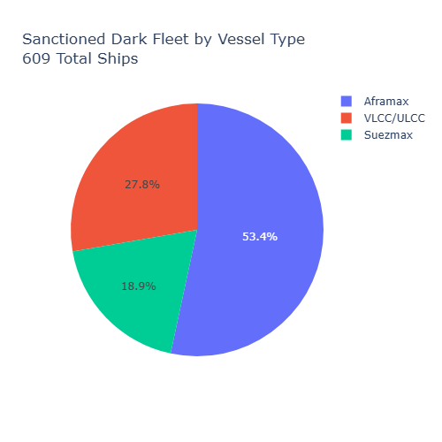
Dark Fleet Overview
Normal distribution of build year
~ 20 years average sanction vessel age

Slide 8
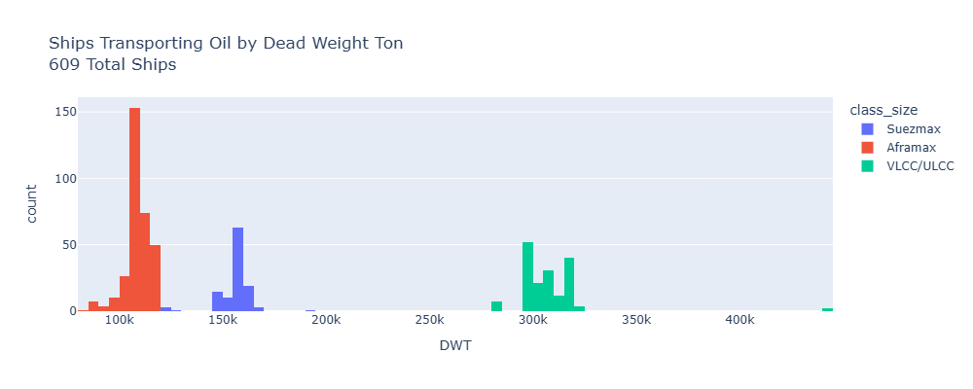
Dark Fleet Overview
Normal distribution of build year
~ 20 years average sanction vessel age

Slide 9
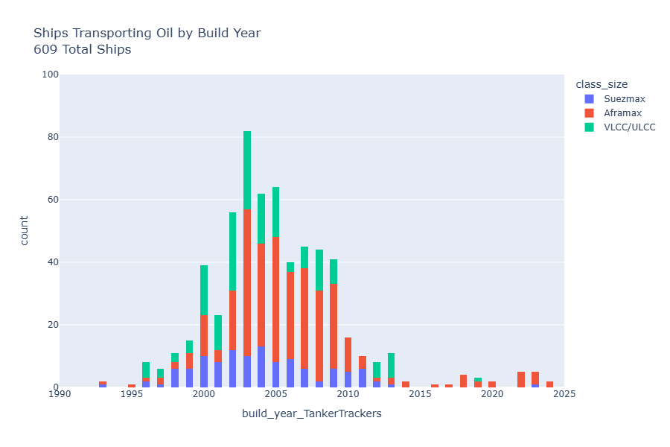
Dark Fleet Overview
Normal distribution of build year
~ 20 years average sanction vessel age

Slide 10
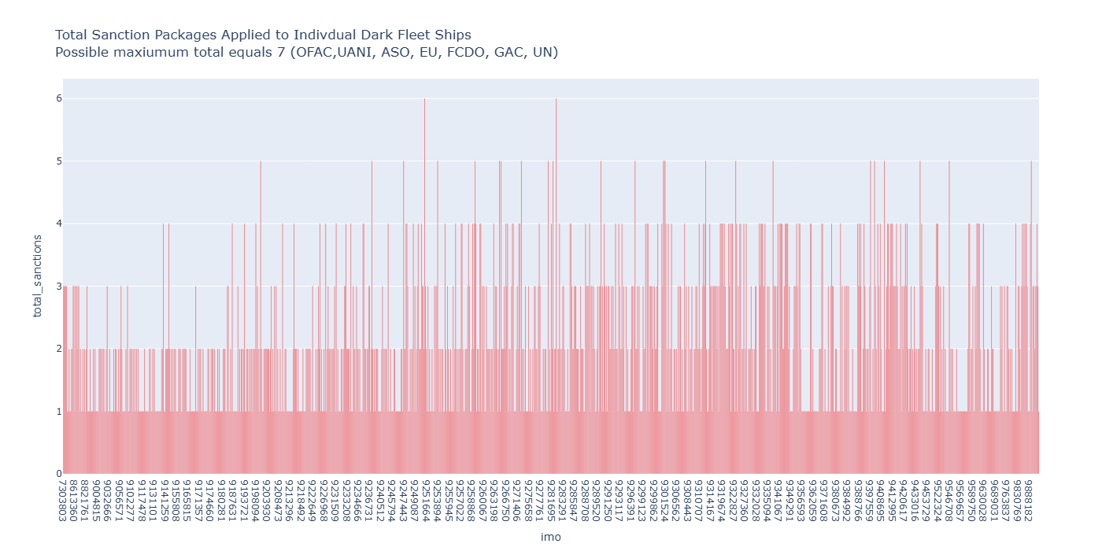
Dark Fleet Overview
Normal distribution of build year
~ 20 years average sanction vessel age

Slide 11
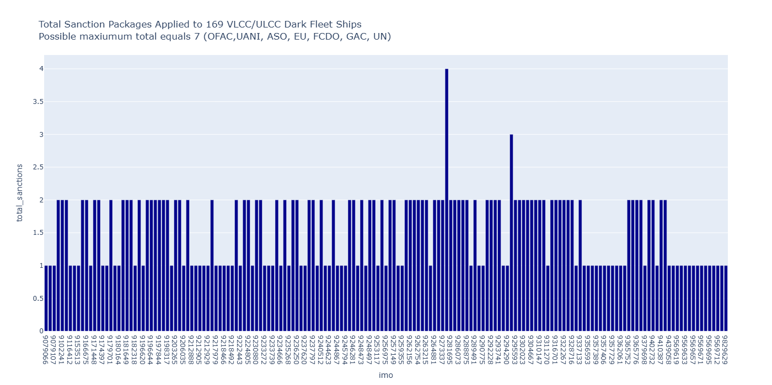
Dark Fleet Overview
Normal distribution of build year
~ 20 years average sanction vessel age

